Slide 1






- AYUSH YADAV

Slide 2
Description –
The dataset provided is related to IMDB Movies. A potential problem to investigate could be: "What factors influence the success of a movie on IMDB?" Here, success can be defined by high IMDB ratings. The impact of this problem is significant for movie producers, directors, and investors who want to understand what makes a movie successful to make informed decisions in their future projects.
IMDb registered users can cast a vote (from 1 to 10) on every released title in the database. Individual votes are then aggregated and summarized as a single IMDb rating, this rating describes the popularity of a movie in the public.
Approach-
First, I analyze the dataset in MS Excel to find out that there are 5043 rows, 28 columns and 1 header row containing the column names.
Then, after looking at the given questions, we find out that most columns are not required to find out the solution. So, we remove the following columns:
1.color 2.num_critic_for_reviews 3.director_facebook_likes
actor_3_facebook_likes
actor_2_name
actor_1_facebook_likes

Slide 3
num_voted_users
cast_total_facebook_likes
actor_3_name
facenumber_in_poster
plot_keywords
movie_imdb_link
num_user_for_reviews
Country
content_rating 16.actor_2_facebook_likes
aspect_ratio
movie_facebook_likes.
After that I cleared all the rows containing any null values as we don’t need them. Now we are left with 3884 rows on the basis of which we made our analysis.
After that I removed the movies that were duplicate using remove duplicates function.
Tech Used - Microsoft Excel

Slide 4
A. Movie Genre Analysis: Analyze the distribution of movie genres and their impact on the IMDB score.
Our task: Determine the most common genres of movies in the dataset. Then, for each genre, calculate descriptive statistics (mean, median, mode, range, variance, standard deviation) of the IMDB scores.

Slide 5
First of all I used text to columns function in “Data tab” to separate the multiple genres being written in a single column - to different columns. These has given me 7 columns with separated genres.
Now I have created a separate table containing names of genres in first rows and IMDB rating list corresponding to that genres
Using the following formula:
=IF(Table9[@Column1]=$U$1,Table1[@[imdb_score]],IF(Table9[@Column2]=$U$ 1,Table1[@[imdb_score]],IF(Table9[@Column3]=$U$1,Table1[@[imdb_score]],IF(
Table9[@Column4]=$U$1,Table1[@[imdb_score]],IF(Table9[@Column5]=$U$1,Ta
ble1[@[imdb_score]],IF(Table9[@Column6]=$U$1,Table1[@[imdb_score]],IF(Tabl e9[@Column7]=$U$1,Table1[@[imdb_score]])))))))

Slide 6
Then I have replaced all the false values with blanks and removed the blanks. Similarly for all the genres.
This has given a table as follows:
The imdb rating for all the genres are now classified. Then calculates descriptive statistics by using following:
For the count For the mean
=COUNTIF($M$2:$S$3786,'IMDB_Movies data'!$U2)
=AVERAGE(AM2:AM1960)
For the median =MEDIAN(AM2:AM1960) For the mode =MODE.SNGL(AM2:AM1960)
For the maximum =MAX(AM2:AM1960)
For the minimum =MIN(AM2:AM1960)
For the range
= simply (maximum – minimum) =Z2-AA2
For the variance =VAR.P(AM2:AM1960)
For the std deviation = we have 2 ways to square root variance or
=STDEV.P(AM2:AM1960)

Slide 7
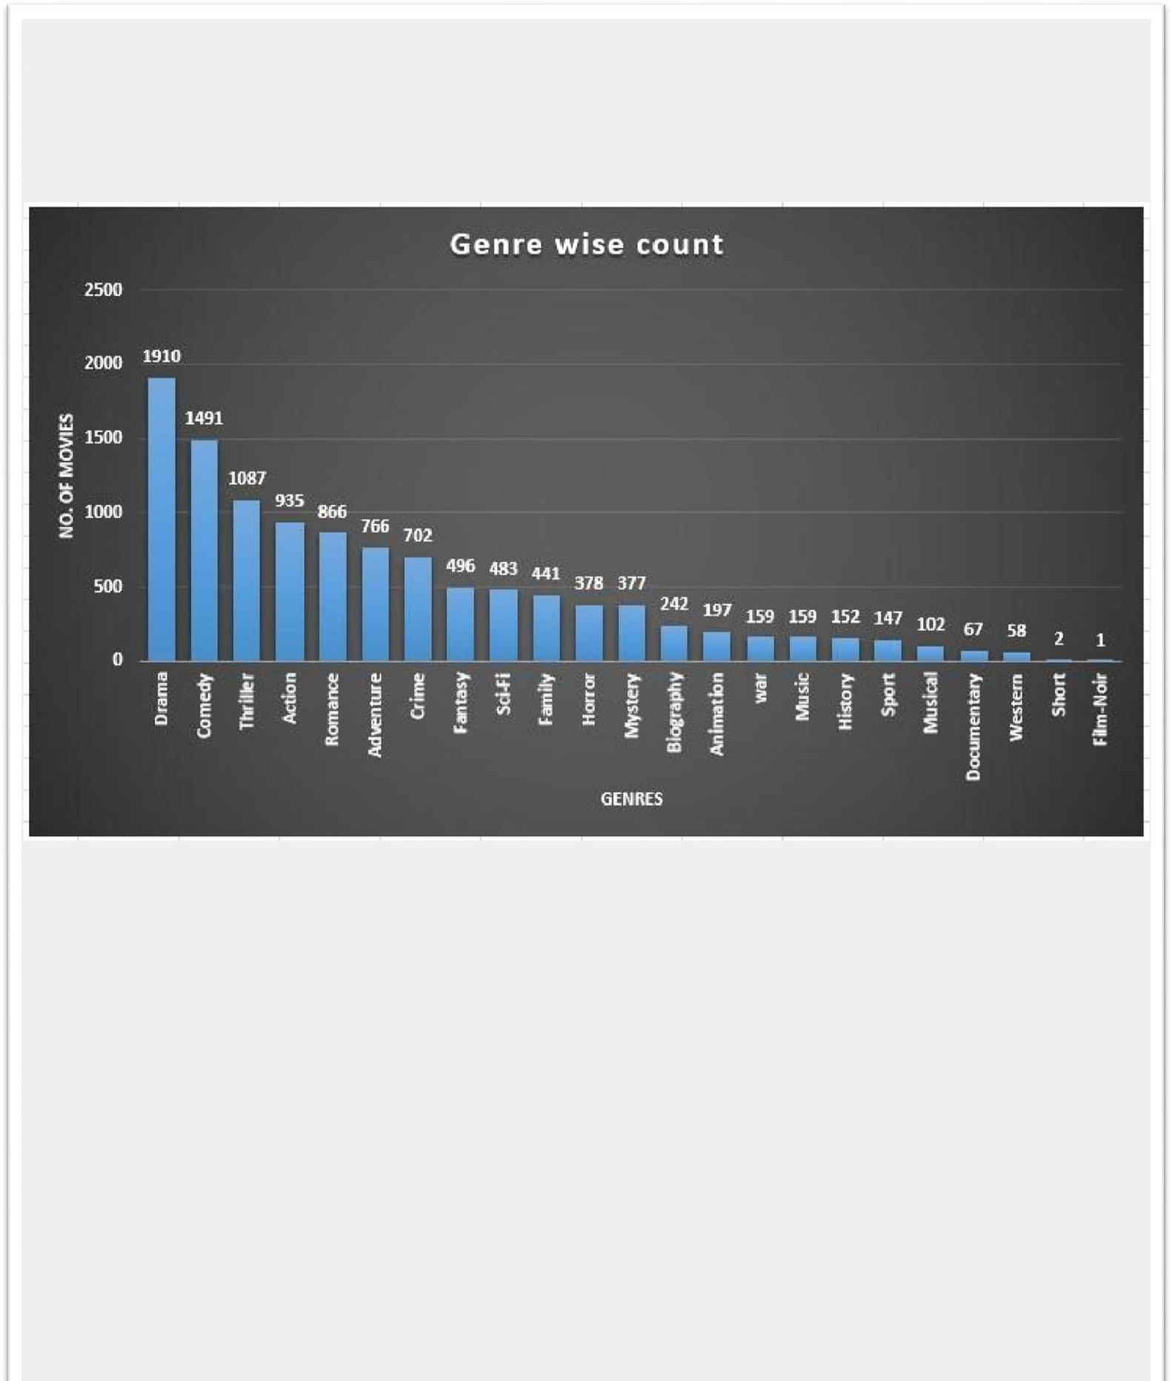
We found that he maximum number of movies belong to Drama genre.

Slide 8
B. Movie Duration Analysis: Analyse the distribution of movie durations and its impact on the IMDB score.
Our Task: Analyse the distribution of movie durations and identify the relationship between movie duration and IMDB score.
Instead of calculating statistics for each movie I created class intervals to analyse the case better.
I wrote first class interval by hand and for subsequent I used the formula:
=RIGHT(CR2,2)+1 & "-" & RIGHT(CR2,2)+20
In this also I have created a separate table showing class interval in minutes in top rows and list of the imbd rating belonging to that class interval by using the following formula :
=IF((B2>=21)*(B2<=40),K2) i.e. =if((duration>=21)*(duration<=40),give me imdb)
Then I have replaced all the false values with blanks and removed the blanks.

Slide 9
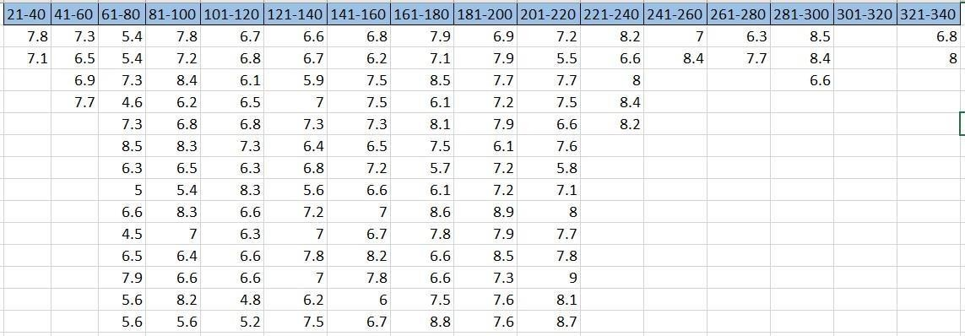
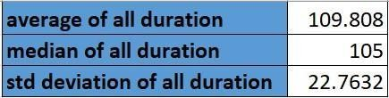
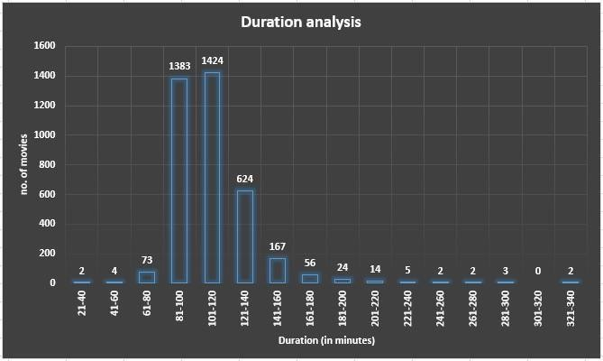
To calculate count: =COUNTIFS('IMDB_Movies data'!$B$2:$B$3786,">=21",'IMDB_Movies data'!$B$2:$B$3786,"<=40")
To calculate average: To calculate median:
=AVERAGE(BJ2:BJ3)
To calculate std deviation:
=MEDIAN(DB1:DB4)
=STDEV.P(DB1:DB4)
However the averages and median and std deviation for all the duration is as follows:

Slide 10
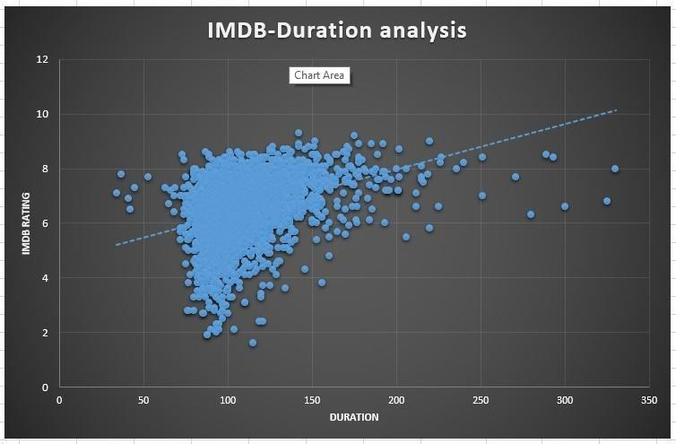
we found that movie with duration 100-120 minutes has maximum number of movies, but the average imdb is highest for 221-240 minutes. The highest median imdb is in 281-300 minutes. The trend line shows that most of the imdb rating are between 75-150 minutes.
Conclusion:
C.
Language Analysis:
Situation: Examine the distribution of
movies based on their language.
Our Task:
Determine the most common languages used in
movies and analyse their impact on the IMDB score using descriptive statistics.

Slide 11
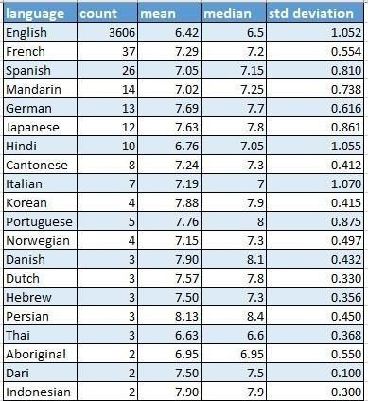
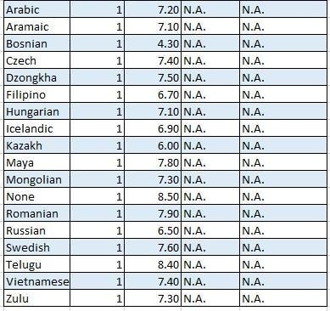
Results:

Slide 12
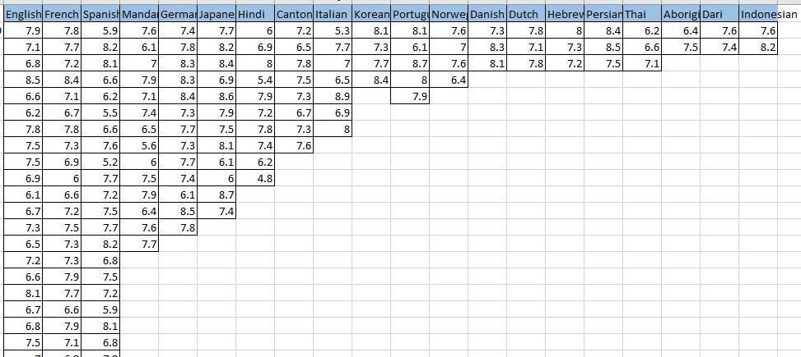
Formula used:
In this also first of all I created a table with language names of the top and list of imbd belonging to that language.
I used =IF(G2=$BJ$1,K2) i.e., =if(language=English, imdb rating) formula to get the imdb rating and Then I have replaced all the false values with blanks and removed the blanks.
Now calculating mean median std deviation becomes very easy for each language.
For count :
=COUNTIF('IMDB_Movies data'!$G$2:$G$3786,'IMDB_Movies data'!$BD2)
For mean: =
AVERAGEIF('IMDB_Movies data'!$G$2:$G$3786,'IMDB_Movies
For median:
data'!$BD2,'IMDB_Movies data'!$K$2:$K$3786)
For std deviation
=MEDIAN(BK2:BK3704)
: =STDEV.P(BK2:BK3704)
Since the proportion of English language is highest, pie chart would be appropriate.

Slide 13
the language in which majority of movies are made is English i.e., 3703. This amounts to 95% of the movies under analysis. The maximum std deviation is of Italian movies.
D. Director Analysis: Influence of directors on movie ratings. Our Task: Identify the top directors based on their average IMDB score and analyze their contribution to the success of movies using percentile calculations.

Slide 14
for calculating number of movies of each director:
=COUNTIF('IMDB_Movies data'!$A$2:$A$3786,CF2)
For average of imbd director wise:
=AVERAGEIF('IMDB_Movies data'!$A$2:$A$3786,CF2,'IMDB_Movies data'!$K$2:$K$3786)
for calculating percentile rank:
=PERCENTRANK.INC([average imdb],[@[average imdb]])*100
the maximum number of movies were made by “steven Spielberg” I.e., 25 movies. However, the percentile rank of average imdb is highest of “tony kaye”. But since he has made only one movie so this won’t be an appropriate means of analysing.

Slide 15
E. Budget Analysis: Explore the relationship between movie budgets and their financial success.
Our Task: Analyze the correlation between movie budgets and
gross earnings, and identify the movies with the highest profit margin.
for profit simply used earnings less budgeted cost , =CL2-CM2 for profit percentage = (earnings/ cost)*100, =(CN2/CM2)*100
for correlation coefficient =CORREL(Table13[gross earnings],Table13[budget])

Slide 16
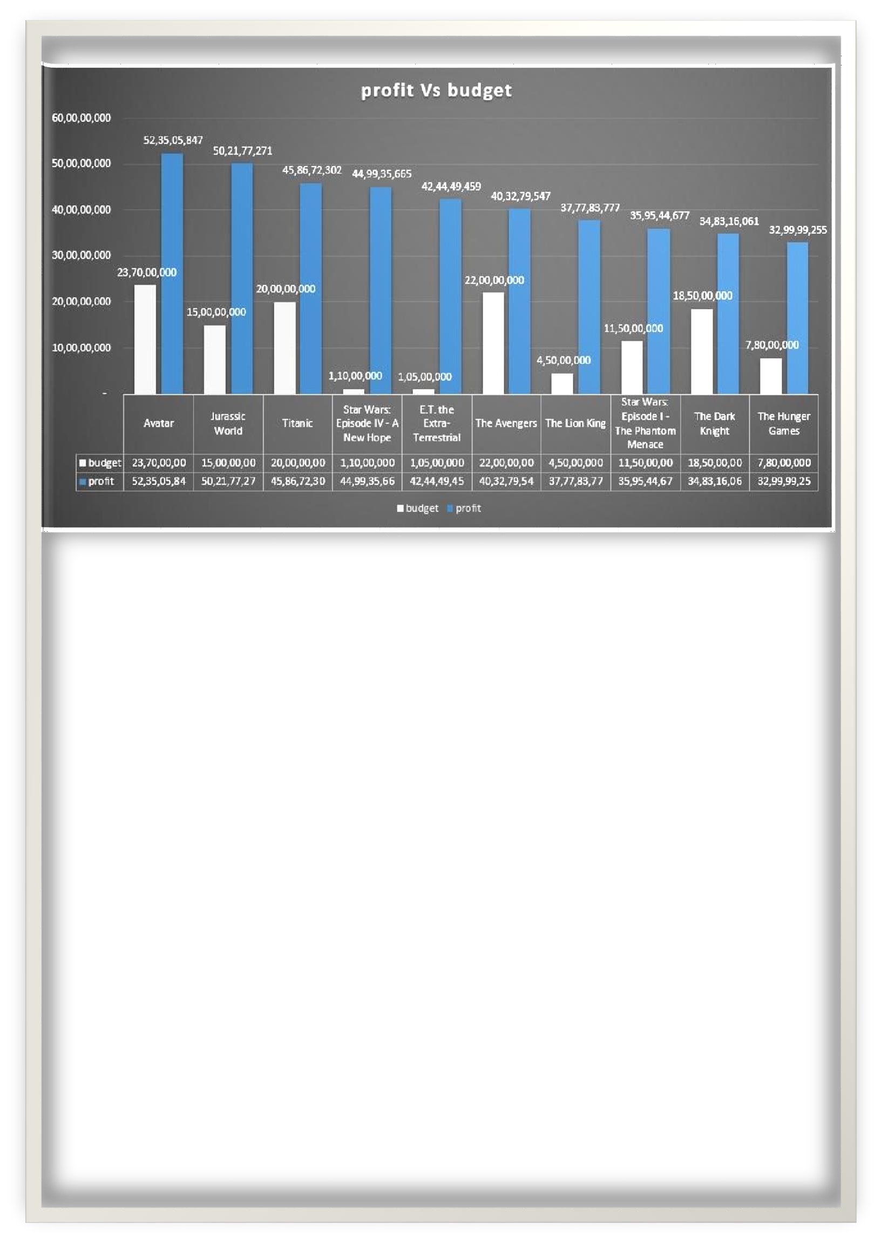
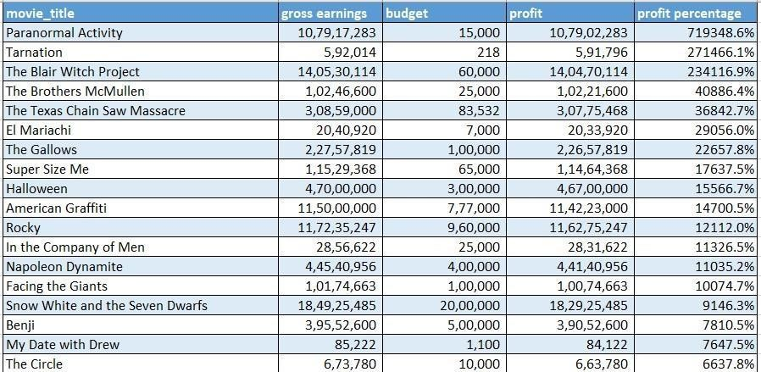
Sorting according to percentile ranking:
Conclusion: the maximum profit is of “avatar” movie which is Rs. 52,35,05,847.
However, the profit percent is highest of the “paranormal activity” i.e., 719348.6%. The data seems to be suspicious as the movie is made in only 15,000. Also the correlation coefficient between earnings and budget is 0.102038454.

Slide 17
What I have learned from this project-
While doing this project learnt a lot about data- cleaning and approach you need to take and also its importance by lots of trial and error.
Also learnt a lot about tables and its pros and usage
And lastly learnt a lot about dealing with databases and things need to be done for certain desired outcomes.
For viewing the detailed excel sheet for this project: Click here

